Slide 1
STD of N and U at few samples
results by simulations, not by chi square…

Slide 2
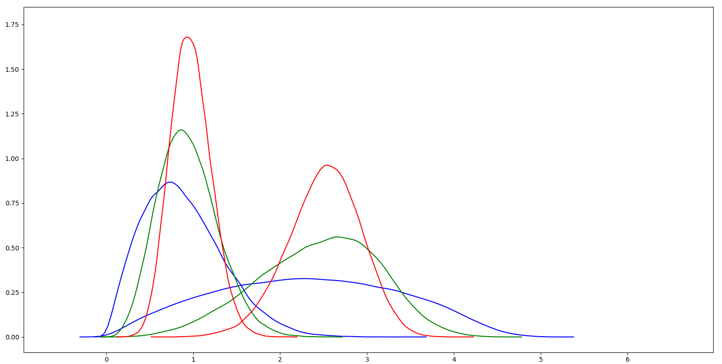
STD of N and U at 3, 5 and 10 samples (without fixing bias…)

Slide 3
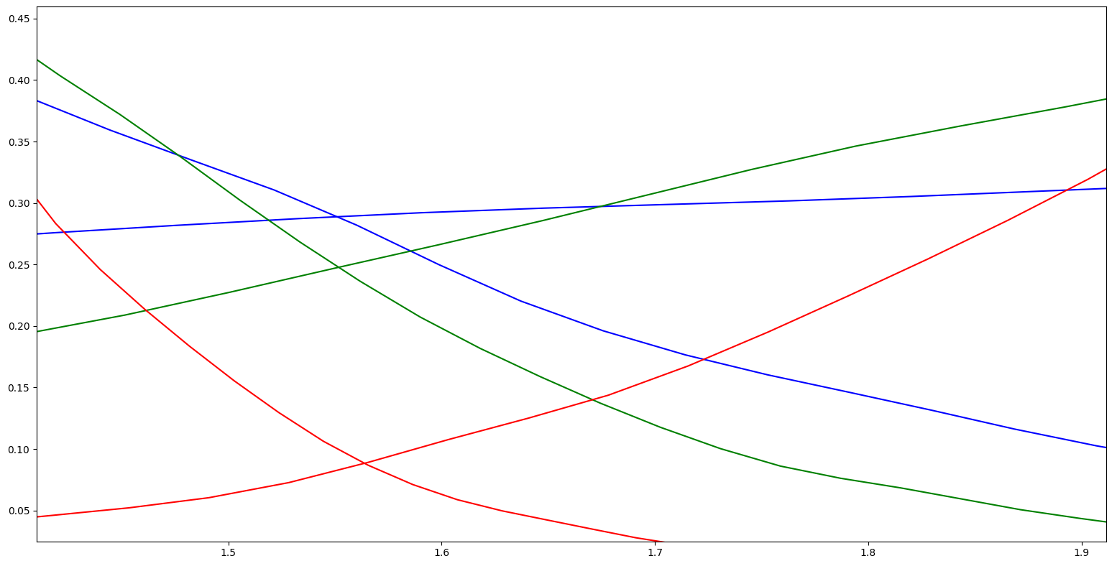
zoom

Slide 4
python code
import pandas as pd import numpy as np import pylab as plt import seaborn as sns from scipy.stats import chi,gamma r = 10000 mu = 0 sigma = 10.0 mu = 0 sigma = 1.0 r = 1000 # number of simulations, put 100000 for more accuracy c = 10 # max number of samples per simulation N = pd.DataFrame(np.random.normal(mu, sigma, [r, c])) U = pd.DataFrame(np.random.uniform(-4.4, 4.4, [r, c])) ax={} color=['r','g','b'] print("done randoming") for i in [10, 5, 3]: # taking i samples out from c N['not_fixed_sigma_' + str(i)] = N.apply(lambda row: row[:i].std(), axis=1) N['fixed_sigma_' + str(i)] = N['not_fixed_sigma_' + str(i)] * i / (i - 1) U['not_fixed_sigma_' + str(i)] = U.apply(lambda row: row[:i].std(), axis=1) U['fixed_sigma_' + str(i)] = U['not_fixed_sigma_' + str(i)] * i / (i - 1) c=color.pop() ax[i]=sns.distplot(U['not_fixed_sigma_'+str(i)],kde=True, hist=False,color=c) sns.distplot(N['not_fixed_sigma_'+str(i)],kde=True, hist=False,color=c,ax=ax[i]) print("done calculating std") bins = int(round(r / 50)) ax=N[[i for i in N.columns if str(i).startswith("not_fixed_sigma_")]].plot.hist(bins=bins, alpha=0.2, title="without correction",normed=True) U[[i for i in U.columns if str(i).startswith("not_fixed_sigma_")]].plot.hist(bins=bins, alpha=0.2, title="without correction",normed=True,ax=ax) ax=N[[i for i in N.columns if str(i).startswith("fixed_sigma_")]].plot.hist(bins=bins, alpha=0.2, title="with correction",normed=True) U[[i for i in U.columns if str(i).startswith("fixed_sigma_")]].plot.hist(bins=bins, alpha=0.2, title="with correction",normed=True,ax=ax) # sns.distplot(U[[i for i in U.columns if str(i).startswith("fixed_sigma_")]], fit=gamma) # ax=sns.distplot(U['not_fixed_sigma_3'], fit=gamma,kde=False, hist=False,ax=ax) # ax=N['not_fixed_sigma_5'].plot.hist(bins=bins, alpha=0.2, title="with correction",normed=True) # U['not_fixed_sigma_5'].plot.hist(bins=bins, alpha=0.2, title="with correction",normed=True,ax=ax) plt.show()

